Slide 1
Roosevelt Lakers
Scouting report

Slide 2
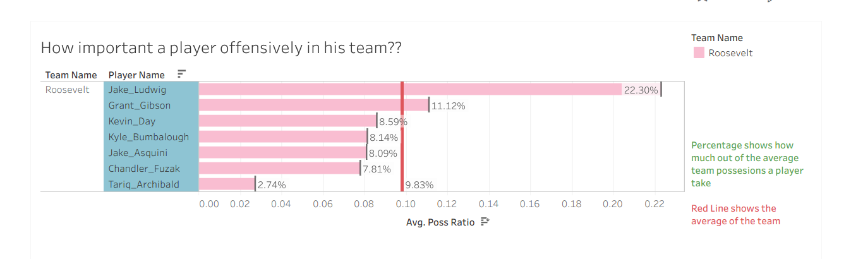
Who are playing this season
Chandler_Fuzak
Grant_Gibson
Jake_Asquini
Jake_Ludwig
Kevin_Day
Kyle_Bumbalough
Tariq_Archibald
68.8% percentage of the last year’s total possesions are still playing

Slide 3
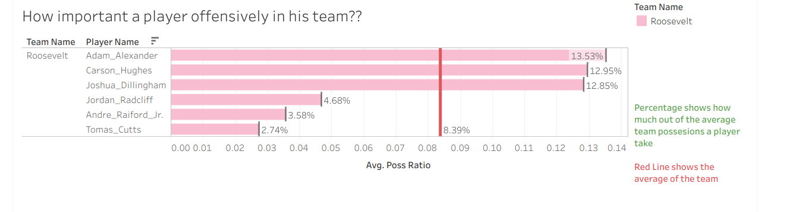
Who are gone
Adam_Alexander
Andre_Raiford_Jr.
Carson_Hughes
Jordan_Radcliff
Joshua_Dillingham
Tomas_Cutts
1/3 of the old players are gone

